Slide 1
Predicting Student Performance
An Analysis of Attendance, Study Habits, and Parental Influence

Slide 2
Introduction
Understanding student performance is crucial for improving education policies. This study explores the impact of attendance, parental education, study habits, and parental support on GPA.

Slide 3
Statistical Question
The research question: How do attendance, parental education, study hours, and parental support influence GPA? We aim to identify trends and correlations using statistical analysis.

Slide 4
EDA Findings
Key variables analyzed:
- StudyTimeWeekly: Hours studied per week
- Absences: Number of days absent
- Parental Education: Parental academic background
- Parental Support: Level of parental academic support
- GPA: Student’s final academic performance score.
Histograms show GPA is approximately normal, while study time and absences exhibit right-skewed distributions.

Slide 5
PMF and CDF Analysis
PMF Analysis:
Students with 10 or fewer absences have a higher probability of achieving better GPAs.
CDF Analysis:
50% of students study less than 10 hours per week.
80% of students study less than 15 hours per week.
These insights highlight the importance of study habits and attendance on academic success.

Slide 6
Regression Analysis
Multiple linear regression results:
R² = 0.918 (strong predictive power)
MSE = 0.0676 (low error)
Key insights:
Study time positively affects GPA (+0.029 per study hour).
Absences negatively impact GPA (-0.099 per absence).
Parental Support has a minor positive effect (+0.149), while Parental Education has minimal impact (-0.001).

Slide 7
Hypothesis Testing
A t-test was conducted to determine the effect of attendance on GPA.
p-value = 0.0, indicating a statistically significant impact.
This confirms that students with high attendance perform significantly better academically.

Slide 8
Conclusion
Findings suggest:
Attendance and study habits are the strongest predictors of GPA.
Parental support has a smaller but positive effect.
Encouraging better attendance and study habits can enhance student success.
Future research should explore additional socio-economic factors and non-linear models.

Slide 9
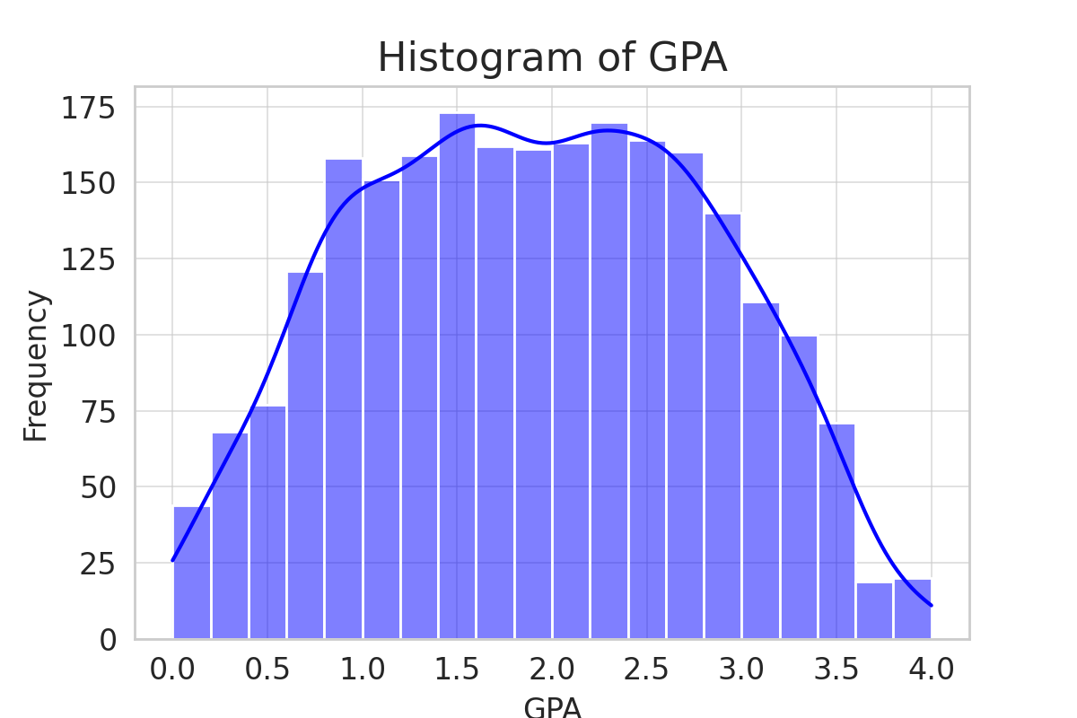
Histogram of GPA

Slide 10
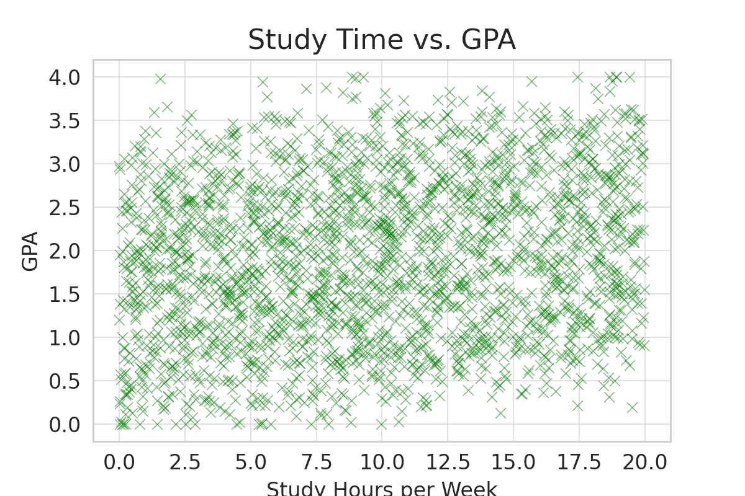
Scatter Plot: Study Time vs. GPA

Slide 11
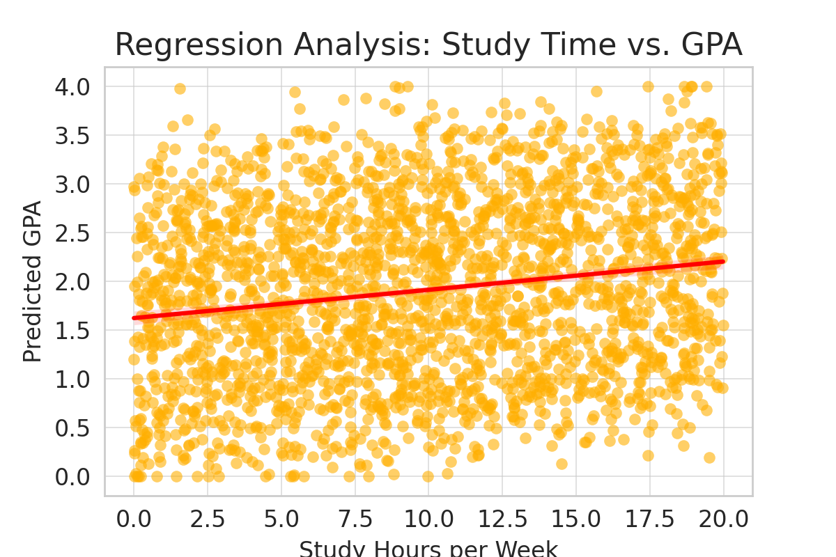
Regression Analysis: Study Time vs. GPA

